Slide 1
Fundamentals of Microsoft-Teams
Build a basic Microsoft Teams Bot

Slide 2

Build a basic Microsoft Teams Bot
Overview of building a Microsoft Teams Bot
Bot Framework vs Webhook (Custom Bot)
Conversation Basics
Channel Conversations and 1:1 Conversations
Messages, Cards and Actions
Events
Testing your Bot
DEMO

Slide 3



Overview of building a Microsoft Teams Bot
Design a great bot
Be responsive – respond to messages and events
Recognize and respond to questions and non-questions
Have a personality
Develop your bot
Bot Builder SDK for .NET
Bot Builder SDK for Node.js
Register and deploy your bot
Get a Bot ID and App ID/Secret and configure bot
Make sure bot is reachable from the internet
Enable analytics

Slide 4

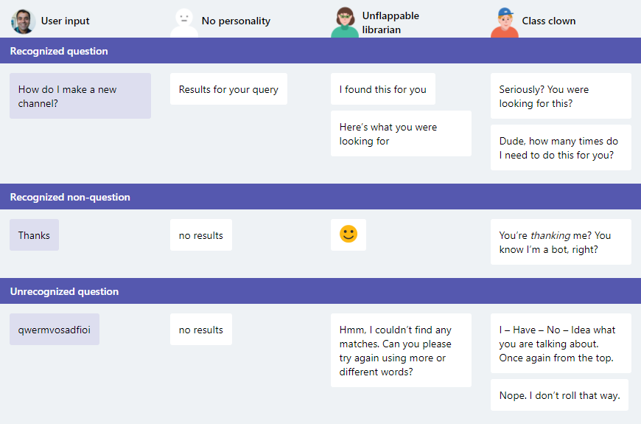
Examples of bot personality and response types

Slide 5
Conversation basics
Activity objects are used to pass information back and forth between bot and channel (or user).
Messages property
Text (Plain / Markdown)
Attachments (Simple media / Cards)
Entities (Users, Bot client)
Dialogs manage conversation flow
Pre & Post events for prompts & replies
Dialog stack and state managed by Bot Framework
Values passed to/from dialogs
StateService
User
Conversation
Private (User in Conversation)
Notes:
Dialog example (https://github.com/Microsoft/BotBuilder-Samples/tree/master/CSharp/core-BasicMultiDialog):
Root dialog calls Name dialog
Name dialog prompts for name. Upon response, returns to caller passing name via Context.Done() method
Root dialog calls Age dialog, passing name. (Pass via constructor on class)
Age dialog prompts “Hello [name], what is your age?”. Upon response, returns to caller passing name via Context.Done() method
User state applies to user for all conversations
Conversation state applies to all users in that conversation
Private state applies to current user in current conversation

Slide 6
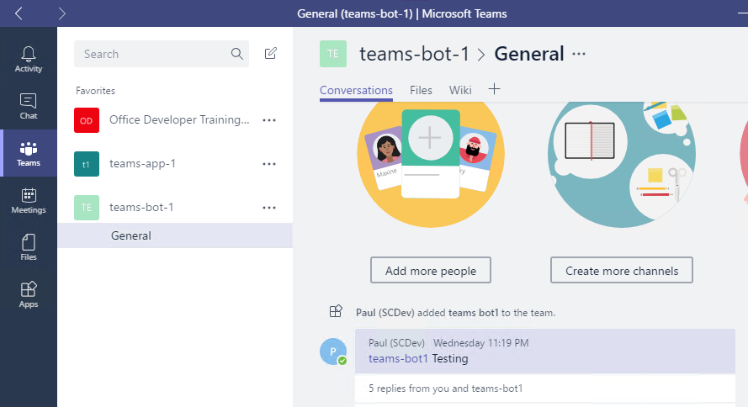
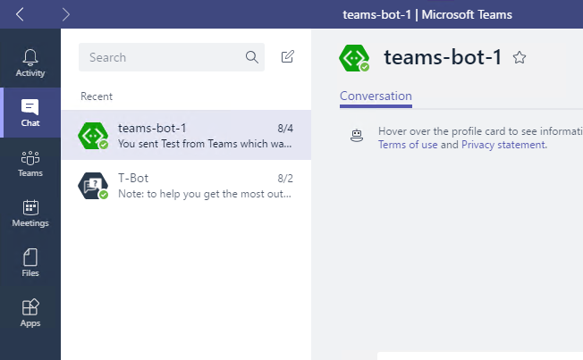
Channel conversations and 1:1 conversations
Channel conversation
Access to channel data, including members
Events when users added/removed from channel
Messages will contain ‘at’ (@) references
1:1 conversation
Access only to user – not team
Event when user initiates conversation
No ‘at’ references

Slide 7


Messages – Text formats
Format | From user to bot | From bot to user | Notes
Rich text |  |  | Basic markdown, no tables
Pictures |  |  | Maximum 1024×1024 and 1 MB in PNG, JPEG, or GIF format; animated GIF not officially supported
Cards |  |  | Currently supports Hero, Thumbnail, and Office 365 Connector cards
Emojis |  |  | Currently supports emojis via UTF-16 (such as U+1F600 for grinning face)

Slide 8

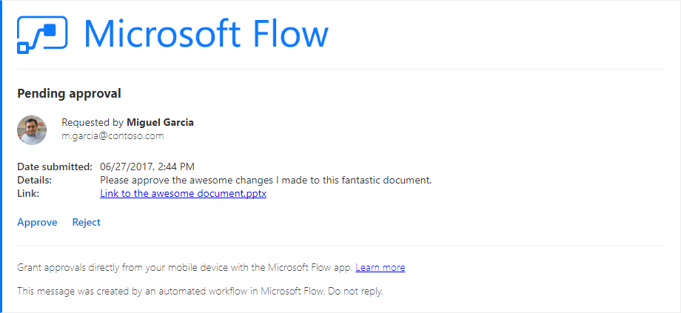
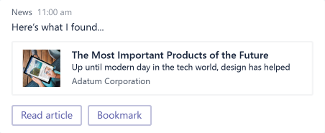
Cards
Hero
Largest card
Best used for articles, long descriptions or scenarios where your image is telling most of the story
Thumbnail
Short and sweet
Ideal for short answers, or if you want to return several cards at once to provide options
Good for deep link to tab or service
Office 365 Connector Card
Most flexible
Provides for multiple sections, images and fields
Also supported in O365 Groups (Exchange)

Slide 9
Actions
Actions require a type, value and title. The title is displayed in the card. The type/values perform specific actions:
CardAction.Type | CardAction.Value
openUrl | URL to be opened in the built-in browser
imBack | Text of the message to send to the bot (from the user who clicked the button or tapped the card). This message (from user to bot) will be visible to all conversation participants *Not recommended for bots in channels
invoke | Payload of message to send to the bot (from the user who clicked the button or tapped the card). This message will not be visible.

Slide 10
Events
Activity objects are used to pass information back and forth between bot and channel (or user). Activities can represent Events, denoted by ActivityType == ‘conversationUpdate’
Team Member Events
teamMemberAdded
teamMemberRemoved
Payload object contains added/removed members
*Adding bot fires this event
Channel Events
channelCreated
channelRenamed
channelDeleted
ChannelData object reflects current state
Team Events
teamRenamed
ChannelData object reflects current state
Notes:
Teams will send notifications to your bot for changes or events that happen in contexts where your bot is active. You can use these events to trigger service logic, such as:
Trigger welcome message when your bot is added to a team.
Query and cache team information when the bot is added to a team.
Updated cached information on team membership or channel information changes.
Remove cached information for a team if the bot is removed.
Since bot is scoped to team, no events for team creation/deletion provided.
When bot is added/removed, TeamMember events are sent.

Slide 11
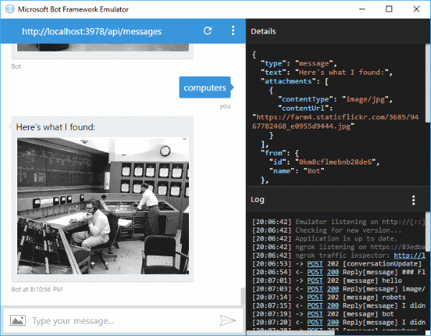
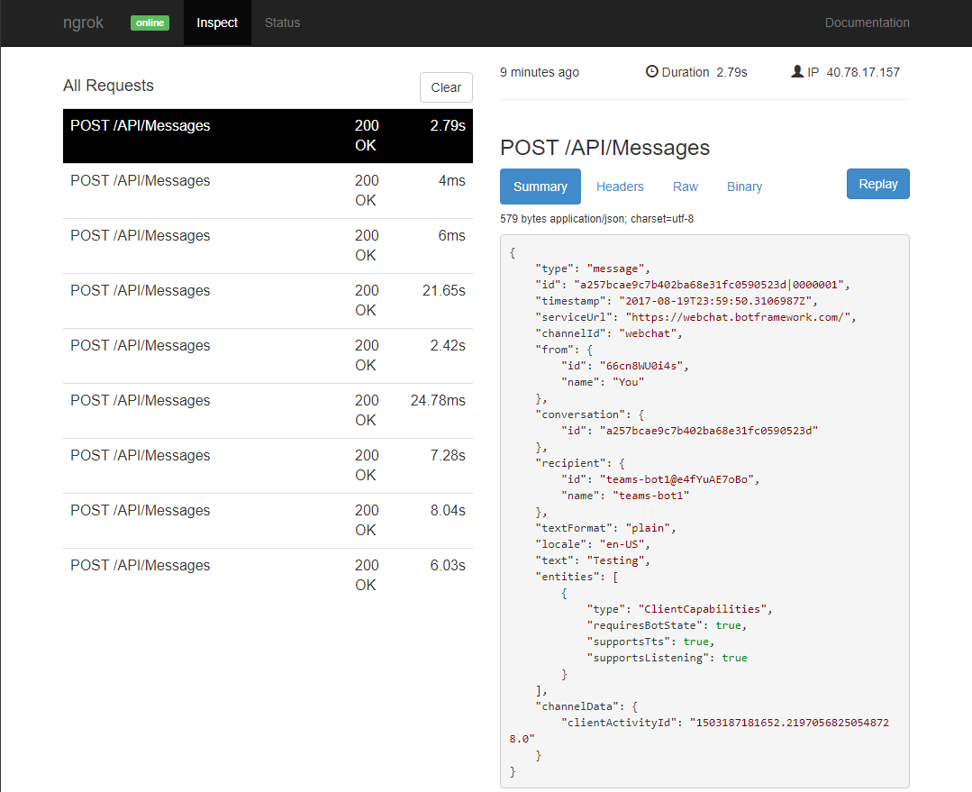
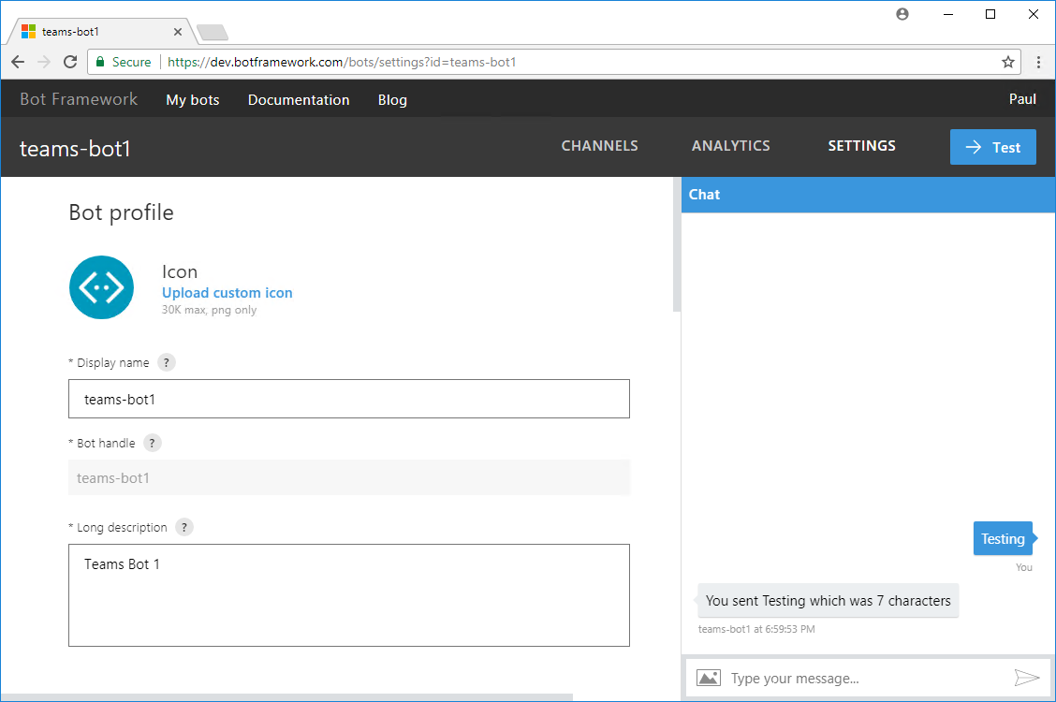
Testing your Bot
Bot registration portal
Help confirm registration settings
Simulates 1:1 conversation
Bot Framework Emulator
Separate download
Does not require registration
Can connect to bot on localhost
Supports speech recognition
Send sample Team Member Events
ngrok Tunnel
Separate download
Forwards internet requests to local machine
Allows inspection of request/response
Notes:
Emulator download page: https://emulator.botframework.com/

Slide 12
Demo Create a basic Teams Bot using Visual Studio

Slide 13

Summary

Slide 14
Thank you

